Slide 1
Software measurement

Slide 2
Software measurement
Software measurement is concerned with deriving a numeric value for an attribute of a software system.
For example, complexity, reliability etc.
Quality product: measured value of an attribute ≈ organizational standards
If the above criteria holds, then there is no need to conduct reviews and product is said to be effective.
There are few established standards in this area.

Slide 3
Software metric
Any type of measurement which relates to a software system, process or related documentation. E.g.,
Lines of code in a program,
the Fog index - test for code readability
No. of reported faults in projects
number of person - days required to develop a component.
Code complexity
Code reliability
Software metric could be :
Control / process metric: imply process management (e.g., avg. effort / time required for reporting faults)
Predictor /product metric : predicts software characteristics

Slide 4
Types of process metric
The time taken for a particular process to be completed
This can be the total time devoted to the process, calendar time, the time spent on the process by particular engineers, and so on.
The resources required for a particular process
Resources include total effort in person-days, computer resources etc.
The number of occurrences of a particular event
the number of defects discovered during code inspection,
the number of requirements changes requested,
the number of bug reports in a delivered system
the average number of lines of code modified in response to a requirements change.

Slide 5
Examples of product metric
Cyclomatic complexity of the module
Average length of identifiers in the program
No. of attributes & operations associated with object classes in design.

Slide 6
Predictor and control measurements
Control metrics and predictor metrics affect the management decisions .
Management decides if the product is ready for release or might need other updating.

Slide 7
Use of measurements
To assign a value to system quality attributes
Assess system quality attributes by measuring them
Example, assess maintainability by calculating cyclomatic complexity.
To identify the system components whose quality is below standard
Measurements can identify individual components with characteristics that deviate from the norm.
For example, you can measure components to discover those with the highest complexity. These are most likely to contain bugs because the complexity makes them harder to understand.

Slide 8
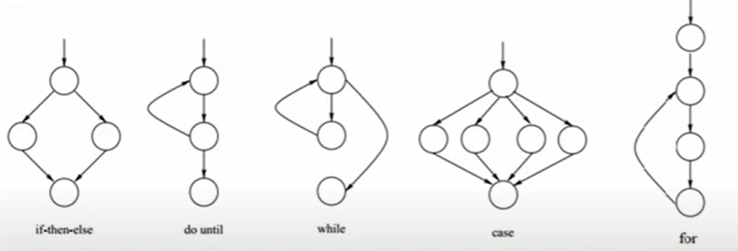
Cyclomatic complexity
Number of independent parts in a program - system maintainability improves
Lesser the cyclomatic complexity, better is the code.

Slide 9
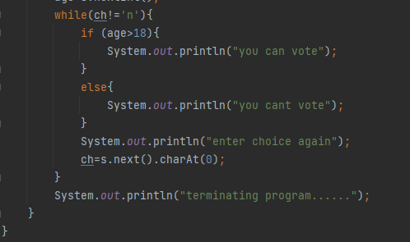
Cyclomatic complexity
Check for Number of independent parts in a program
Lesser the cyclomatic complexity, better is the code.
CC = E – N + 2P
Where,
E = edges
N = nodes
P = no. of connected components

Slide 10
Metrics assumptions
Difficult to measure some attributes like maintainability, understandability and usability
As they depend on user experience or how developer use it.
So you have to measure the size/complexity to estimate these attributes
We can only measure internal attributes but are often more interested in external software attributes. So a relationship is shown in next figure.

Slide 11
Relationships between internal and external attributes

Slide 12
3 conditions for quantifying relationship between attributes
Internal attributes measured correctly
Relationship must hold between internal attribute & external quality attribute.
That relationship should be explained in terms of a numerical value or model for better understanding.

Slide 13
Problems with Software measurement in industry
Software measurement is still immature in industry. Not fully practiced.
Impossible to predict the return on investment of introducing an organizational metrics program.
no standards defined for software metrics or for measurement and analysis.
software processes are not standardized and are poorly defined and controlled.
Previous on software measurement is on code-based metrics or plan-driven development processes. But nowadays, mostly reusing existing applications or agile methods are is used
Introducing measurement adds additional overhead to processes. Contradiction with agile methods

Slide 14
Product metrics
A quality metric to predict the product quality.
Classes of product metric
Dynamic metric
Collected during or after system testing.
E.g., no. of bugs reported, time to complete a task.
Assess efficiency & reliability
Static metric
collected by measuring the system representations like design, program or documentation.
Examples shown in upcoming slides.

Slide 15
Dynamic and static metrics
Dynamic metrics are closely related to software quality attributes
It is relatively easy to measure the response time of a system (performance attribute) or the number of failures (reliability attribute).
Static metrics have an indirect relationship with quality attributes
You need to try and derive a relationship between these metrics and properties such as complexity, understandability and maintainability.

Slide 16
Static software product metrics
Software metric | Description
Fan-in/Fan-out | Fan-in = number of functions that call the particular function (say X). Fan-out = number of functions that are called by function X. A high value for fan-in means that X is tightly coupled to the rest of the design and changes to X will have extensive knock-on effects. A high value for fan-out suggests that the overall complexity of X may be high because of the complexity of the control logic needed to coordinate the called components.
Length of code | This is a measure of the size of a program. Generally, the larger the size of the code of a component, the more complex and error-prone that component is likely to be. Length of code has been shown to be one of the most reliable metrics for predicting error-proneness in components.
Cyclomatic complexity | This is a measure of the control complexity of a program. This control complexity may be related to program understandability.
Length of identifiers | This is a measure of the average length of identifiers (names for variables, classes, methods, etc.) in a program. The longer the identifiers, the more likely they are to be meaningful and hence the more understandable the program.

Slide 17
Static software product metrics
Software metric | Description
Depth of conditional nesting | This is a measure of the depth of nesting of if-statements in a program. Deeply nested if-statements are hard to understand and potentially error-prone.
Fog index | This is a measure of the average length of words and sentences in documents. The higher the value of a document’s Fog index, the more difficult the document is to understand.

Slide 18
The CK object-oriented metrics suite
Object-oriented metric | Description
Weighted methods per class (WMC) | Multiple methods in a class. Calculate complexity for every method ranging from 1 to a higher value depending on complexity. ↑ value for WMC = ↑complex the object class. Complex objects are difficult to understand. Not reused as super classes in an inheritance tree.
Depth of inheritance tree (DIT) | This represents the number of discrete levels in the inheritance tree where subclasses inherit attributes and operations (methods) from super classes. The deeper the inheritance tree, the more complex the design. Many object classes may have to be understood to understand the object classes at the leaves of the tree.
Number of children (NOC) | This is a measure of the number of immediate subclasses in a class. measures the breadth of a class hierarchy, whereas DIT measures its depth. ↑ NOC = ↑ reuse. It may mean that more effort should be made in validating base classes because of the number of subclasses that depend on them.

Slide 19
The CK object-oriented metrics suite
Object-oriented metric | Description
Coupling between object classes (CBO) | Classes are coupled when methods in one class use methods or instance variables defined in a different class. CBO is a measure of how much coupling exists. A high value for CBO means that classes are highly dependent, and therefore it is more likely that changing one class will affect other classes in the program.
Response for a class (RFC) | RFC is a measure of the number of methods that could potentially be executed in response to a message received by an object of that class. Again, RFC is related to complexity. The higher the value for RFC, the more complex a class.
Lack of cohesion in methods (LCOM) | LCOM is calculated by considering pairs of methods in a class. LCOM is the difference between the number of method pairs without shared attributes and the number of method pairs with shared attributes. It is not clear if it really adds any additional, useful information over and above that provided by other metrics.

Slide 20
Software component analysis
System component can be analyzed separately using a range of metrics.
The assessed values then compared with historical measurement data collected on previous projects.
Anomalous measurements i.e., deviating values shows the issue in the component

Slide 21


The process of product measurement
Assess core components only
Is it because of a quality compromise or some other issues?
Check for unusual high/low values

Slide 22
Measurement ambiguity
When you collect quantitative data about software and software processes, you have to analyze that data to understand its meaning.
It is easy to misinterpret data and to make inferences that are incorrect.
You cannot simply look at the data on its own. You must also consider the context where the data is collected.

Slide 23
Measurement surprises
Reducing the number of faults in a program leads to an increased number of help desk calls
The program is now thought of as more reliable and so has a wider more diverse market. The percentage of users who call the help desk may have decreased but the total may increase;
A more reliable system is used in a different way from a system where users work around the faults. This leads to more help desk calls.

Slide 24
Software context
Processes and products that are being measured are not insulated from their environment.
The business environment is constantly changing and it is impossible to avoid changes to work practice just because they may make comparisons of data invalid.
Data about human activities cannot always be taken at face value. The reasons why a measured value changes are often ambiguous. These reasons must be investigated in detail before drawing conclusions from any measurements that have been made.

Slide 25
Software analytics
Software analytics is analytics on software data for managers and software engineers with the aim of empowering software development individuals and teams to gain and share insight from their data to make better decisions.

Slide 26
Software analytics enablers
The automated collection of user data by software product companies when their product is used.
If the software fails, information about the failure and the state of the system can be sent over the Internet from the user’s computer to servers run by the product developer.
The use of open source software available on platforms such as Sourceforge and GitHub and open source repositories of software engineering data.
The source code of open source software is available for automated analysis and this can sometimes be linked with data in the open source repository.

Slide 27
Analytics tool use
Tools should be easy to use as managers are unlikely to have experience with analysis.
•Tools should run quickly and produce concise outputs rather than large volumes of information.
•Tools should make many measurements using as many parameters as possible. It is impossible to predict in advance what insights might emerge.
• Tools should be interactive and allow managers and developers to explore the analyses.

Slide 28
Status of software analytics
Software analytics is still immature and it is too early to say what effect it will have.
Not only are there general problems of ‘big data’ processing, our knowledge depends on collected data from large companies.
This is primarily from software products and it is unclear if the tools and techniques that are appropriate for products can also be used with custom software.
Small companies are unlikely to invest in the data collection systems that are required for automated analysis so may not be able to use software analytics.

